Slide 1
Mental Health Services Act Representative Stakeholder Steering Committee Plan Update 2019/2020
Friday, October 18, 2019
Behavioral Health and Recovery Services

Slide 2
Opening Session
Ruben Imperial, MBA
Behavioral Health Director (Interim)

Slide 3
BHRS 2017/2018
Treatment
Prevention & Early Intervention
8,668
SMI Treatment
2,719
SUD Treatment
224
State Hospital/IMD/TBC
194
Conservatorship
5,137
SMI/SED Outreach and Support Services
3,147
Early Intervention
6,700
SUD Prevention, Outreach & Support
1,575
Prevention Support
64,000
MH Awareness, Education & Engagement

Slide 4
BHRS Strategic Planning Update
Planning Priorities Assessment
Access & Coordination of Care
Treatment Capacity-building
Core Treatment for SMI/SUD
Conservatorship
Substance Use Disorders Treatment
Priority Population: Homelessness
Administrative & Support

Slide 5
Planning Priorities
Conservatorship: Develop an overall conservatorship strategy that defines the coordination of care, evidence-based interventions, placement capacity, and the treatment capacity needed to serve the population (MHSA Proposal).
Substance Abuse Treatment: Develop a vision for a community-wide drug and alcohol treatment system, leveraging new opportunities with the Medi-Cal Organized Delivery System. This vision would include both county and private sector efforts, making up a broad Continuum of Care to effectively serve local priority populations, such as the individuals experiencing homelessness or those identified through our CARE program.

Slide 6
Planning Priorities
Homelessness:
Develop a homelessness coordinated system of care strategy within the behavioral health system that clearly identifies the number of BHRS clients that are experiencing homelessness, real-time housing and shelter waitlist, and evidence-based SUD/MH interventions.
This defined system of care should include interventions for addressing behavioral health issues and accessing the spectrum of care to include prevention, mild/moderate, early intervention and treatment for SMI.

Slide 7
MHSA Essential Elements
Community Collaboration
Cultural Competence
Client/Family driven mental health system
Wellness Focus – Recovery and Resilience
Integrated Service Experiences for clients and their families

Slide 8
MHSA Funding
78.5% Community Supports & Services
CSS provides direct treatment and recovery to individuals of all ages living with serious mental illness or emotional disbalances
18.5% Prevention & Early Intervention
PEI targets individuals of all ages prior to the onset of mental illness.
5% Innovation
Innovation funds projects to introduce new approaches or community-driven best practices that have not been proven to be effective.

Slide 9
MHSA Funding
MHSA funds may only be used for approved plans
Stakeholder input and local planning processes are necessary
Supplantation of existing state or county funds with MHSA funds is not allowed
Plan Update vs. Annual Update

Slide 10
Purpose of Convening
Share Information
Facilitate Meaningful stakeholder engagement
Ensure we gather diverse perspectives
Develop shared understanding of proposals and recommendations

Slide 11
Reducing Homelessness for Individuals with Severe Mental Illness

Slide 12
BHRS Shelter & Housing Partnerships
Category | Project | Partner(s) | Jurisdiction | # of Units | # of Beds | Funding source | Estimated Date of Availability
TH | Women's REST | STANCO/BHRS/ Modesto | Modesto | 1 | 5 | MHSA CSS | September 2019
PSH | Palm Valley | Housing Authority | Modesto | 39 | 10 | MHSA Housing | October 2019
PSH | Granger Project | STANCO/BHRS/Modesto | Modesto | 4 | 4 | MHSA Housing | November 2019
PSH | King Kennedy Cottages | Housing Authority/BHRS/Modesto | Modesto | 23 | 4 | NPLH Comp | June 2020
Shelter | Access Center | Salvation Army/County/Modesto | Modesto | - | 182 | MHSA GSD | November 2019
PSH | Kansas House | Housing Authority/BHRS/Modesto | Modesto | 100 | 60 | NPLH Non-Comp and MHSA Housing | Jan 2020
PSH | Kestrel Ridge | Housing Authority/BHRS | Modesto | 8 | 8 | MHSA Housing | April 2020
PSH | Palm Ave Cottages | Housing Authority/BHRS/Turlock | Turlock | 4 | 4 | NPLH Comp | June 2020
PSH | Park Street Cottages | Housing Authority/BHRS/Turlock | Turlock | 8 | 8 | NPLH Comp | June 2020
Transitional Housing = TH Permanent Supportive Housing = PSH

Slide 13
Kansas House Project
722 Kansas Avenue, Modesto
103 Permanent Supportive Apartment Units
60 Beds designated for BHRS
House approximately 200 individuals
Interior Renovations – Kitchenette, Washer/Dryer Combo & Loft Bed/Couch
Exterior Renovations – paint, signage, landscaping, fencing
Placement by referral only basis
On-site management
Intensive case casement

Slide 14
Kansas House: Overall Funding Strategy
Description | Uses | Sources
Acquisition & Rehabilitation | $8,000,000
Stanislaus Regional Housing Authority |  | $2,100,000 | Loan
City of Modesto |  | $2,500,000 | Community Development Block Grant
County of Stanislaus |  | $2,300,000 | No Place Like Home – Noncompetitive Allocation*
County of Stanislaus |  | $1,100,000 | Mental Health Services Act – Housing Funds
Total | $8,000,000 | $8,000,000
*County to provide a non-interest-bearing loan $2.3 million Bridge Loan from the County General Fund pooled cash to allow acquisition and rehabilitation work to move forward expediently.

Slide 15
Access Center & Emergency Shelter

Slide 16
Access Center & Emergency Shelter
The "one-stop" Access Center that will centralize and serve as a physical entry point and service hub for the County's homelessness services system providing access and referrals to a wide-range of housing and supportive services, including embedded behavioral health services, in one location.
Within the homeless population individuals with SMI are over-represented than the general population.

Slide 17
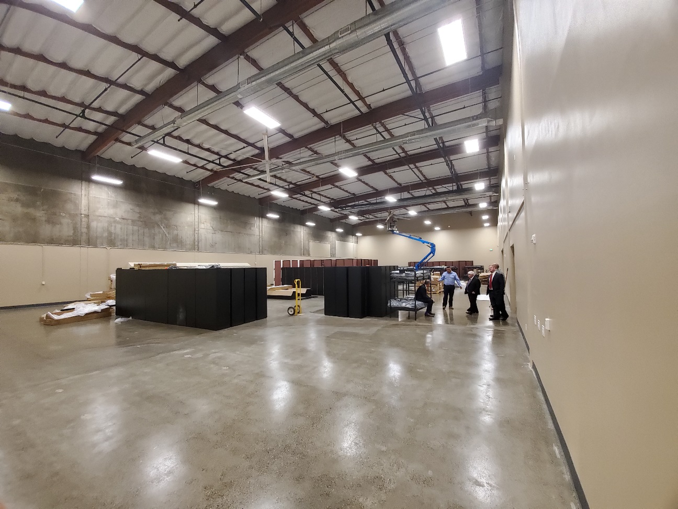
Access Center & Emergency Shelter
Integrated services embedded with 186 emergency shelter beds.
Align/Co-locate behavioral health access, outreach, PEI and treatment services.
Special accommodations shelter space for individuals that have SMI and other behavioral health issues.
Shelter support services and team

Slide 18
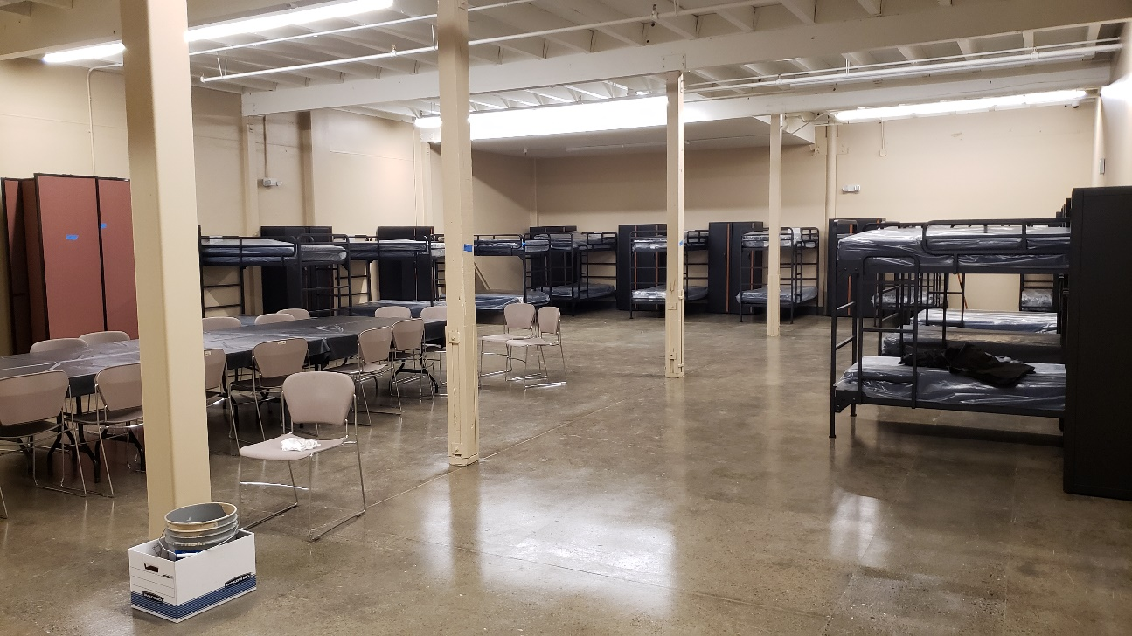
Supportive Housing & Shelter Expansion
With the increase of shelter beds at the Access Center and transitional and permeant supportive housing units, BHRS will expand it current Housing Support staff team to support clients at the new project sites.
It’s imperative that these new shelter and housing resources are complimented with adequate supportive services.
Staff currently assist approximately 200 individuals and family members in maintaining subsidized supportive housing in the community.

Slide 19
Supportive Housing & Shelter Expansion
Supportive services include, but are not limited to:
Independent living skills
Money management
How to get along with your neighbors
Peer support
Connecting to your community,
Relapse prevention
Education
Improving coping skills

Slide 20
Prevention & Early Intervention
The MPEIT will provide outreach, engagement referrals, and brief intervention services for individuals with the aim recognizing early signs of mental illness and improving timely access and linkage to treatment and other support services.
The target population will include adults, children, youth and TAYA residing at the Access Center and other shelters throughout the County.
Services will include direct early intervention services in addition to navigating to appropriate PEI and treatment services and programs.

Slide 21
Division of Housing and Homelessness Services
In order to better coordinate housing and homeless services and provide measurable outcomes, Stanislaus County Board of Supervisors approved the formation of the Division of Housing and Homeless Services (DHHS) within Community Services Agency (CSA).
Integrate and oversee all existing internal CSA housing and homeless programs and supportive services as well as oversee designated Countywide homeless and housing projects, including projects targeting individuals with SMI.
This new Division will have a direct impact in improving access to shelter beds and housing units for BHRS clients with severe mental illness.

Slide 22
Division of Housing and Homelessness Services
Administrative Responsibilities Managed Under New Division
Outreach and Engagement Center
Outreach and Engagement Team
Housing Assessment Team
Access Center and Emergency Shelter
Stanislaus Homeless Alliance
Community System of Care
Oversight of designated Countywide housing and homeless projects

Slide 23
Prudent Reserve Assessment Therapeutic Foster Care
Kara Anguiano Chief Fiscal Officer

Slide 24
Prudent Reserve Assessment – Maximum
Pursuant to the Department of Health Care Services (DHCS) Information Notice 19-017, each County is required to establish a Prudent Reserve that does not exceed 33% of the average Community Services and Supports (CSS) revenue received for the Local Mental Health Services Fund (LMHSF) in the preceding five years. Each county must reassess this amount every five years.
BHRS performed the Prudent Reserve Assessment calculation and has determined that the current Prudent Reserve Level is within the 33%, and no additional action is required at this time. BHRS submitted the documentation to DHCS prior to June 30, 2019.

Slide 25
Prudent Reserve Assessment - Minimum
DHCS is also in the process of issuing regulations that will require Counties to establish a minimum prudent reserve of at least 23% of the average CSS revenue received for the LMHSF in the preceding five years.
In an effort to be proactive and avoid having to prepare an additional FY 2019-2020 Plan Update in the event the regulation becomes effective prior to June 30, 2020, BHRS has performed the Prudent Reserve Assessment calculation and has determined that the current Prudent Reserve level does not meet the minimum proposed requirement. Once the new regulation becomes effective, BHRS will transfer $3,182,769 in CSS funds to the Prudent Reserve.

Slide 26
Therapeutic Foster Care
Unfunded mandate that created a new service model to allow for the provision of short-term, intensive, highly coordinated, trauma-informed and individualized Specialty Mental Health Services (SMHS) activities to children and youth up to age 21 in foster care who have complex emotional and behavioral needs.
Children who are placed with trained, intensely supervised, and supported TFC parents will receive intensive and frequent mental health support in a family environment.

Slide 27
Therapeutic Foster Care
CSA is responsible for identifying potential TFC homes and placing children in those homes. BHRS is responsible for providing, or arranging for, SMHS for Medi-Cal beneficiaries that are residents of California.
SMHS are partially reimbursable by Medi-Cal, but require local matching funds
BHRS is recommending that the unfunded mandate of TFC be funded with MHSA CSS funds through the creation of a new General System Development (GSD) program within the CSS component in Fiscal Year 2019-2020 and future fiscal years.

Slide 28
Funding

Slide 29
Next Steps
Plan Update Document posting
Plan update is submitted to the Board of Supervisors for approval
Contracts developed or amended
Proposals will be included in the Plan Update FY 19-20

Slide 30
Discussion

Slide 31
Prevention & Early Intervention Update
Dr. Janet Nuñez-Pineda, Manager

Slide 32
Afghan Path Towards Wellness
APTW is a specialized program for women in the Afghan refugee and Special Immigrant Visa holder population, adapted from the “Pathways to Wellness” Curriculum. The program services are being delivered by International Rescue Committee (IRC). Services include outreach & engagement, screening for emotional distress, social adjustment support groups, peer support and referrals to all levels of behavioral health services. Funding amount up to: $95,000.00 Executed: March, 1, 2019

Slide 33
School Consultation Behavioral Health Integration
SCBHI provides Prevention and Early Intervention behavioral health services to TK-12 grade students, their parents, school staff and broader school community. Target areas for SCBHI include School districts whose students meet MHSA priority populations of [underserved/unserved at risk…]
The SCBHI model integrates consultation, family engagement, community partnerships and student mental health prevention services as a holistic approach. Funding amount: up to $300,000.00. Expected start date November 1, 2019. Provider: Center for Human Services. Districts being served: Chatom, Newman-Crowslanding & Turlock Unified.
Notes:
How presentation will benefit audience: Adult learners are more interested in a subject if they know how or why it is important to them.
Presenter’s level of expertise in the subject: Briefly state your credentials in this area, or explain why participants should listen to you.

Slide 34
RAIZ Promotores Mental Health Prevention Program
RAIZ aims to prevent and reduce mental health stigma and discrimination by strengthening natural communities of support. Request for Proposal (RFP) includes the following ten geographical areas of Stanislaus County.
Funding amount: $750,000.00
Expected start date: January 1, 2020
Ten Geographic Areas
Ceres/Keyes
Denair/Hickman/Waterford
Empire/Hughson
North Modesto/Salida
Oakdale
Riverbank
Turlock
West Modesto
Newman/Crows Landing/Riverdale Park Tract/Monterey Park Tract
Patterson
Notes:
How presentation will benefit audience: Adult learners are more interested in a subject if they know how or why it is important to them.
Presenter’s level of expertise in the subject: Briefly state your credentials in this area, or explain why participants should listen to you.

Slide 35
Community Faith-Based Mental Health Prevention Program
PEI is looking to pilot a specialized Community-Faith based Prevention program that would encompass outreach, stigma reduction and education and formal training to faith based leaders and their members. The program will be inclusive to engaging up multiple faith denominations in Stanislaus county and shall have an emphasis on Recovery. Funding: $150,000.00

Slide 36
Child & Youth Resiliency
Prevention and Early Intervention will fund programming under our current approved PEI plan that align with SB 1004, Wiener. The target population will be children and youth ages 25 and younger. Funding amount available up to $240,000.00 per year. After January 1, 2020

Slide 37
Assessment Center (YAC) Pilot
PEI/Child & Youth Resiliency is partnering with Juvenile Probation Department to pilot at statewide model known as Youth Assessment Center (YAC)
The goal of the YAC pilot program is to engage youth who have had contact with law enforcement for non-violent offenses and are not on formal probation.
The pilot aligns with goals of SB 1004 priorities and can inform our work.
Prevention funded services will include: non-traditional, culturally affirmative, evidenced based services, restorative justice practices, intensive case management, screening for mental health services.
Focus area: The YAC pilot focus area is South and West Modesto due to current Juvenile Probation Department data. Provider: Sierra Vista Child & Family Services-Drop In Center. Funding amount up to: $150,000 per year.

Slide 38
Suicide Prevention Innovation Project
Janelle Villalba, Project Manager

Slide 39
Stanislaus County Suicide Prevention Innovation Project Update
Collective impact brings people together,
in a structured way, to achieve social change.
October 18th, 2019 – Stakeholders Committee Meeting

Slide 40
Outline
Project Background
Project Strategy – Innovation
SPIP Learning Questions
Three-Years in Review
What’s Next

Slide 41
Project Background
Sept. 2015 Stanislaus County Board of Supervisors expressed concern statewide efforts to reduce suicides had not been effective and identified reducing suicide rates as a funding priority
Oct. 2015 MHSA Representative Stakeholder Steering Committee (RSSC) endorsed the Suicide Prevention Project, an initiative to help decrease suicides in Stanislaus County and increase suicide awareness and prevention
April 2016 the Mental Health Services Act Oversight and Accountability Commission approved the Suicide Prevention Innovation Project (SPIP Project started Sept. 2016).

Slide 42
Project Strategy – Innovation
Innovation
Projects contribute to learning about and addressing an unmet need rather than providing direct service
Collective Impact Model (CIM)
The Project utilized and is evaluating the CIM as the promising community driven best practice or adaptive approach
The Collective Impact Model was adopted as the innovative approach for the project because:
Allows for cross-sector perspectives and collaboration
Ability to address complex root causes

Slide 43
SPIP Learning Questions
The learning questions this Project is addressing and evaluating are:
Through collective efforts, will group develop shared understanding of suicide data in our County? If so, how will that shared understanding impact suicide prevention planning?
Can a collaborative use data and combined information from multiple sources to develop a suicide prevention strategic plan that the community will support/embrace?
What methods are most effective in increasing suicide prevention awareness in Stanislaus County?
Will the collaborative impact the rate of suicide in Stanislaus County? Will specific demographic groups be impacted?

Slide 45
What’s Next? In Close. . .
We believe that the Collective Impact model has been useful and effective as an innovative approach allowing for cross-sector perspectives and collaboration as we looked at suicide awareness and prevention in Stanislaus County.
We look forward to the findings of the Evaluation and Final Report and the opportunities for the Project’s learning to be leveraged in Suicide Prevention Planning efforts going forward.
We are hopeful that the new level of community collaboration that has occurred in part to this project will continue and grow into the future.
We are hopeful that the Community Scorecard provided by the Project will be a resource for continued community strategic planning into the future.
We are hopeful that as cross sector community collaborations continue to grow, Stanislaus County will see decrease in the incidences of suicide.

Slide 47
Suicide Prevention Innovation Project
Janelle Villalba, Project Manager
209.281.8805
Tracey McKnight, Staff Services Coordinator 209.289.1946
Amber Gillaspy, Event Planning Specialist
209.525.6208

Slide 48
Thank you for your partnership!

